Slide 1



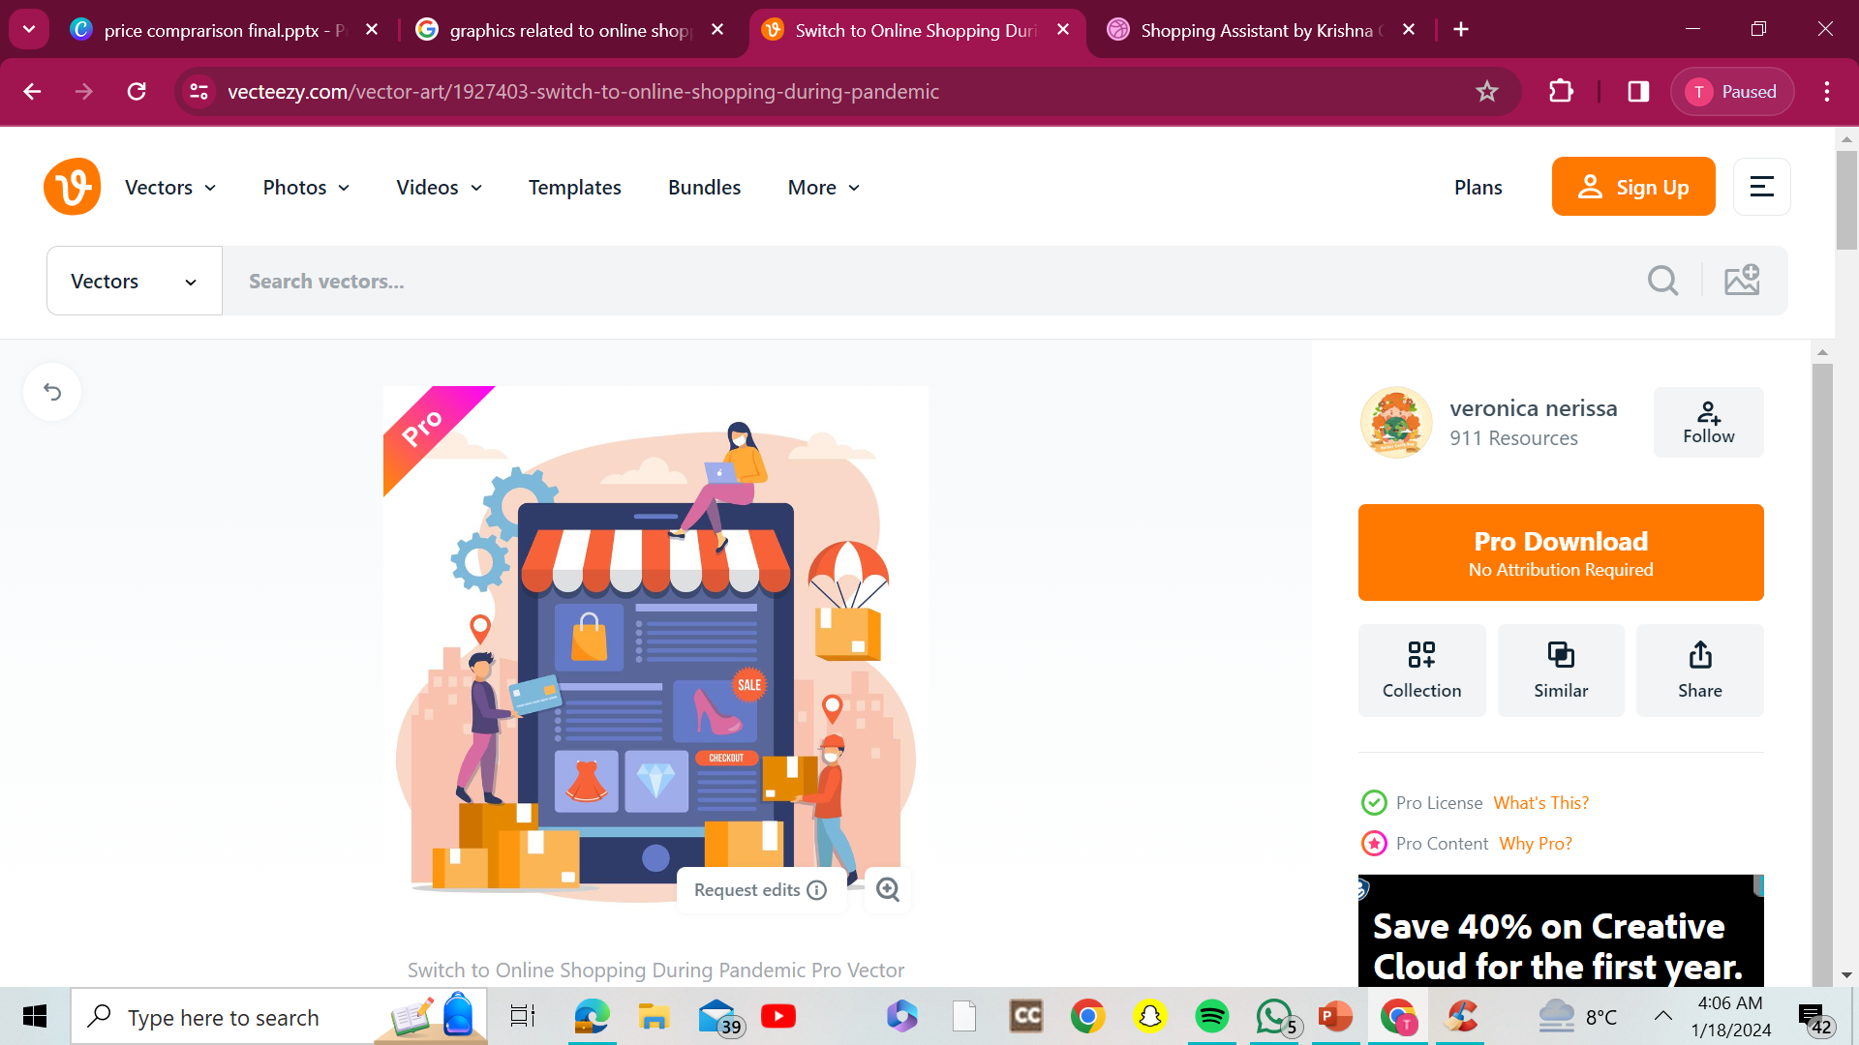



PRICE
Wizard

Slide 2


Meet Our Team:
Raghav Mishra (CSE (AI&ML))
Smriti (CSE (AI&ML))
Tanishk Tyagi (CSE (AI&ML))
Tanushka Nehra (CSE (AI&ML))
Tanushka Verma (CSE (AI&ML))
Urvashi Kushwaha (CSE (AI&ML))
Mentor:
Shristi Dhama (CSE AI)

Slide 3



Problem Statement:
As e-commerce continues to grow exponentially, consumers are faced with an abundance of choices, making informed decision-making crucial.
Today, we explore how price comparison websites empower users to make more informed and cost-effective choices in their online purchases.

Slide 4

INTRODUCTION:
A price comparison website is a platform designed to assist users in comparing the prices of products offered by various online retailers.
These platforms employ data collection methods, such as web scraping and API integration, to gather, aggregate, and present product information in an easily understandable format.

Slide 5
How Price Comparison Websites Work?
Overview of data collection methods:
Price comparison websites utilize various methods, such as web scraping and API integration, to collect and update product information.
Real-time updates for accuracy:
Real-time updates ensure that the information presented is accurate and reflective of the current market.
User interface design for a seamless experience:
Intuitive and user-friendly interfaces enhance the overall shopping experience for users.

Slide 6





TECHSTACK USED:
HTML : To build the structure
CSS :Used in Styling for Visual Appeal
JavaScript : Interactivity and Functionality
Python : Backend Development

Slide 7
REQUIREMENTS
•Performance
•Security
•Scalability
•Reliability
•Usability
•Compliance
•Browser compability
•Response time
FUNCTIONAL REQUIREMENT
•User registration and authentication
•Product database
•Search and filtering
•Price comparison
•Wishlist and cart
•Notification system
•User profiles
•Mobile responsiveness
NON-FUNCTIONAL REQUIREMENT

Slide 8

ARCHITECTURE:
•User interface
•Web server
•Application server
•Database
•External data sources
•User authentication and authorization
•Search and filtering system
•Wishlist and cart
•Payment and integration
•Backup and recovery

Slide 9
Advantages for Consumers
Cost savings and finding the best deals:
Users can identify and seize the most cost-effective options, resulting in significant savings.
Time-saving and streamlining the shopping process:
The convenience of having a centralized location for comparing prices saves valuable time during the shopping experience.
Convenience of accessing a variety of products:
These platforms provide a one-stop-shop for users to access a diverse range of products and sellers.

Slide 10
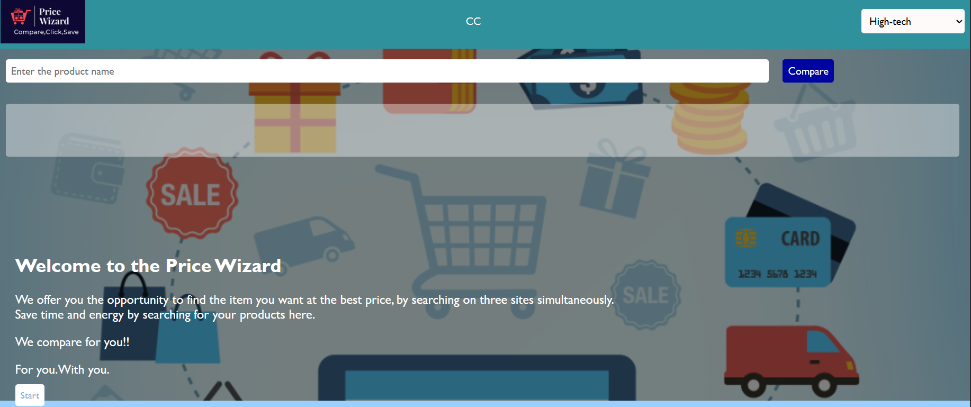
FRONTEND LAYOUT

Slide 11

Thank you for listening!
Don't hesitate to ask any questions!

